Slide 1

Sri Venkateswara College of Engineering and Technology
(Autonomous)
R.V.S Nagar, Chittoor – 517 127. (A.P)
B.Tech – Computer Science and Engineering (AI & ML)
Academic Year:2025 – 2026 Project Title Public Transport Delay Prediction and Scheduling Analytics
Submitted By:
Under the Guidance of Mrs. T. Amruthavalli,M.Tech Associate Professor Department of CSE (AI & ML)
Student Name | Register Number
M. Karthik | 22781A3383
M. Srihari | 22781A3391
T. Harshitha | 22781A33C3
U. Phani Kumar | 22781A33D4
S. Ahmad Basha | 23785A3314

Slide 2
ABSTRACT
Public transport is an essential part of daily travel in urban areas, but delays caused by traffic congestion, weather conditions, and peak-hour demand create uncertainty for commuters. This project focuses on developing a Public Transport Delay Prediction and Scheduling Analytics System using machine learning techniques to predict delay duration and provide realistic arrival time estimates. The system analyzes historical transport data along with contextual factors such as route details, time of travel, and weather conditions to identify delay patterns. It supports multiple transport modes including buses, metro, and trains, and presents the predicted results through a user-friendly web interface. By providing accurate delay information and expected arrival times, the proposed system helps commuters plan their journeys more efficiently and improves the overall reliability of public transport services.

Slide 3
AGENDA
Introduction
Problem Statement
Existing System
Proposed System
System Architecture
Methodology
Implementation
Experimental Setup & Results
Applications
Future Scope
Conclusion

Slide 4
1. INTRODUCTION
Public transport systems such as buses, metro, and trains play a major role in daily commuting, especially in large cities where traffic congestion is high. Although public transport helps reduce travel cost and traffic, delays frequently occur due to factors like traffic congestion, peak-hour rush, weather conditions, road incidents, and operational issues. Most existing transport systems provide only fixed schedules, which do not reflect real-time conditions, leading to inaccurate arrival time information. With the growth of urban population and increasing dependency on public transport, there is a strong need for an intelligent system that can predict delays accurately and provide realistic arrival times. Machine learning techniques offer an effective solution by analyzing historical data and external factors to improve the reliability of public transport services.

Slide 5
2. PROBLEM STATEMENT
Public transport systems operate in dynamic environments where travel time is affected by traffic congestion, weather conditions, peak-hour demand, and operational constraints. Existing transport information systems mainly rely on fixed schedules and historical averages, which fail to provide accurate arrival time predictions under real-world conditions. These systems do not effectively consider external factors such as traffic and weather, resulting in unreliable delay information. As a result, commuters face uncertainty, wasted time, and difficulty in planning their journeys. Therefore, there is a need for an intelligent and data-driven system that can accurately predict public transport delays and provide realistic arrival time estimates to improve travel planning and user experience.

Slide 6
EXISTING SYSTEM
Shows only fixed bus, metro, and train schedules
Arrival time is based on planned timetable, not actual conditions
No delay prediction is provided to passengers
Does not use machine learning or data analytics
Traffic and weather effects are not considered
Passengers cannot know how late the transport will be
LIMITATIONS OF EXISTING SYSTEM
Cannot predict delay duration in minutes
Ignores traffic congestion and peak hours
Weather conditions like rain are not included
Arrival time information is often inaccurate
No explanation for reason of delay
Makes journey planning difficult for commuters

Slide 7
PROPOSED SYSTEM
Predicts delay duration in minutes
Uses Machine Learning to predict public transport delays
Considers traffic conditions, peak hours, and weather data
Supports bus, metro, and train services
Provides expected arrival time instead of only schedule time
Shows possible reason for delay (traffic, weather, peak hour)
Implemented as a user-friendly web application
Helps commuters plan their journey better

Slide 8
ADVANTAGES OF PROPOSED SYSTEM
Provides accurate delay prediction using machine learning
Shows realistic arrival time instead of fixed schedules
Considers traffic, weather, and peak hours
Reduces travel uncertainty for commuters
Improves journey planning and time management
Easy to use web-based application
Supports multiple transport modes (bus, metro, train)
Useful for commuters and transport authorities
LIMITATIONS OF PROPOSED SYSTEM
Prediction accuracy depends on quality of historical data
Does not fully support real-time GPS tracking
Live traffic data is not directly integrated
Weather data accuracy depends on external APIs
Sudden events like accidents or roadblocks may reduce accuracy
Requires internet connection for web application usage
Performance may vary for new or rarely used routes

Slide 9
System Architecture
User Interface (Web Application)
User enters source, destination, transport type, and date
Flask Backend Server
Receives user input
Handles request processing
Data Processing Module
Adds time, peak-hour, and weather features
Prepares input for ML model
Machine Learning Model (XGBoost)
Predicts delay duration in minutes
Learns from historical transport data
SQLite Database
Stores transport schedules, routes, and delay data
Weather API
Provides weather information used in prediction
Result Module
Calculates expected arrival time
Displays delay and reason to user

Slide 10
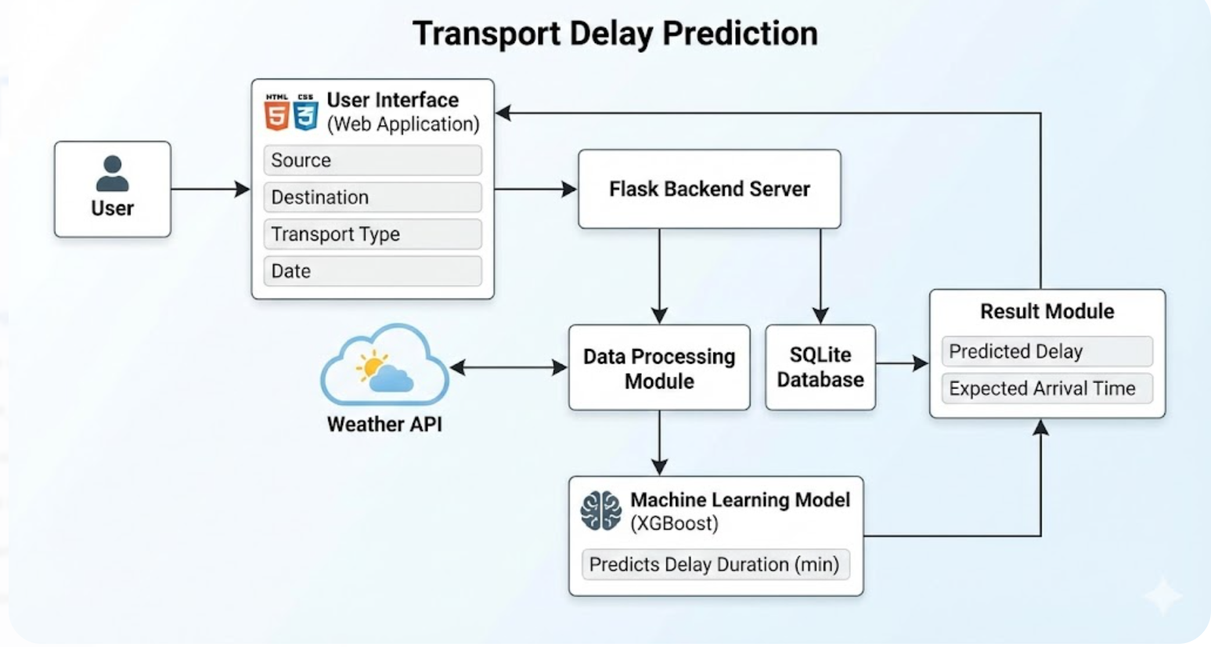

Slide 11
DATA COLLECTION
Collected public transport schedule data (bus, metro, train)
Includes source, destination, route details
Uses scheduled arrival and departure time
Collects time-based data (hour, day, peak hour)
Includes weather data (clear, rainy, cloudy, etc.)
Calculates delay in minutes from actual vs scheduled time
Data represents realistic urban travel conditions

Slide 12
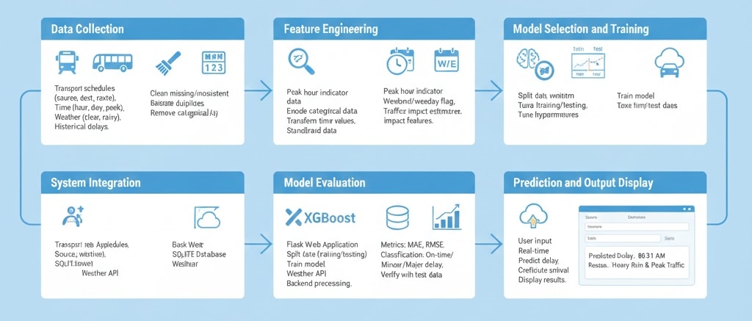
METHODOLOGY
The methodology describes the step-by-step process followed to design and implement the Public Transport Delay Prediction and Scheduling Analytics System. The proposed system uses a machine learning–based approach to predict delay duration and provide realistic arrival times by analyzing historical transport data along with contextual factors such as time and weather.

Slide 13
Step 1: Data Collection
Transport-related data is collected for bus, metro, and train services
Includes source, destination, route, and transport type
Scheduled arrival and departure times are collected
Weather information such as clear, cloudy, rainy conditions is included
Time-based attributes like hour of travel, day, and peak hour are considered
This data represents real-world urban transport scenarios.
Step 2: Data Preprocessing
Missing and inconsistent data is cleaned
Duplicate records are removed
Categorical values (transport type, weather) are converted into numerical format
Date and time values are transformed into useful features
Data is standardized to make it suitable for machine learning
This step ensures the dataset is clean and reliable.
Step 3: Feature Engineering
Important features are derived to improve prediction accuracy
Peak hour indicator is added
Weekend or weekday flag is included
Traffic impact is estimated using time-based patterns
Weather impact features are created
Feature engineering helps the model learn delay patterns more effectively.

Slide 14
Step 4: Model Selection and Training
A machine learning regression model is selected
XGBoost algorithm is used due to its high accuracy and efficiency
The dataset is split into training and testing sets
The model is trained using historical transport data
Hyperparameters are tuned to improve performance
The trained model learns the relationship between input features and delay duration.
Step 5: Model Evaluation
Model performance is evaluated using standard metrics
Mean Absolute Error (MAE) and Root Mean Squared Error (RMSE) are calculated
Delay predictions are classified into on-time, minor delay, and major delay
Accuracy is verified on unseen test data
This step ensures the model gives reliable predictions.

Slide 15
Step 6: System Integration
The trained model is integrated into a Flask-based web application
SQLite database is used to store transport and prediction data
Weather API is connected to fetch environmental data
Backend processes user input and sends it to the ML model
Step 7: Prediction and Output Display
User enters travel details through the web interface
The system processes the input in real time
The machine learning model predicts delay duration
Expected arrival time is calculated
Results are displayed clearly to the user

Slide 16
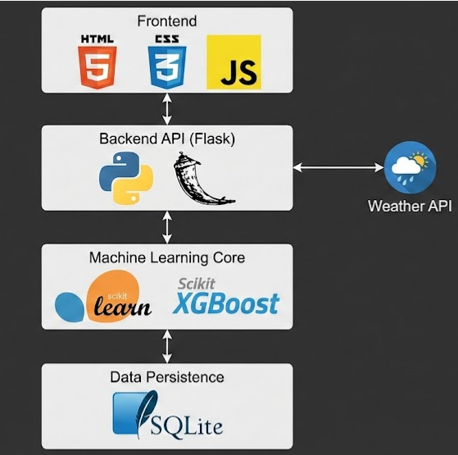
IMPLEMENTATION
The implementation phase converts the proposed design and methodology into a working system. In this project, the Public Transport Delay Prediction and Scheduling Analytics System is implemented using machine learning techniques along with a web-based application.
1. Technology Stack Used
Programming Language: Python
Machine Learning Libraries: Scikit-learn, XGBoost
Web Framework: Flask
Database: SQLite
Frontend Technologies: HTML, CSS, JavaScript
API Used: Weather API

Slide 17
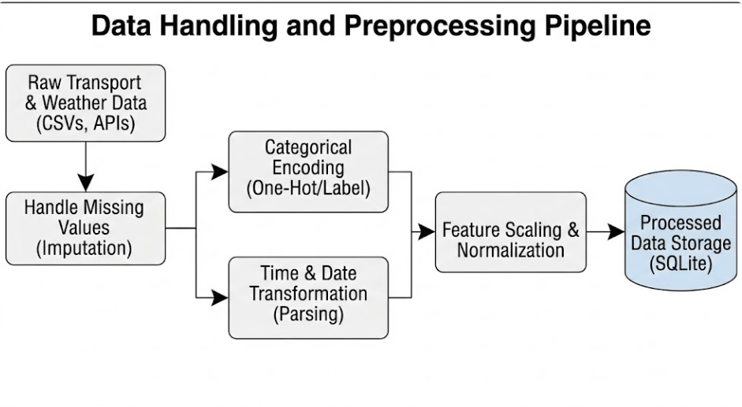
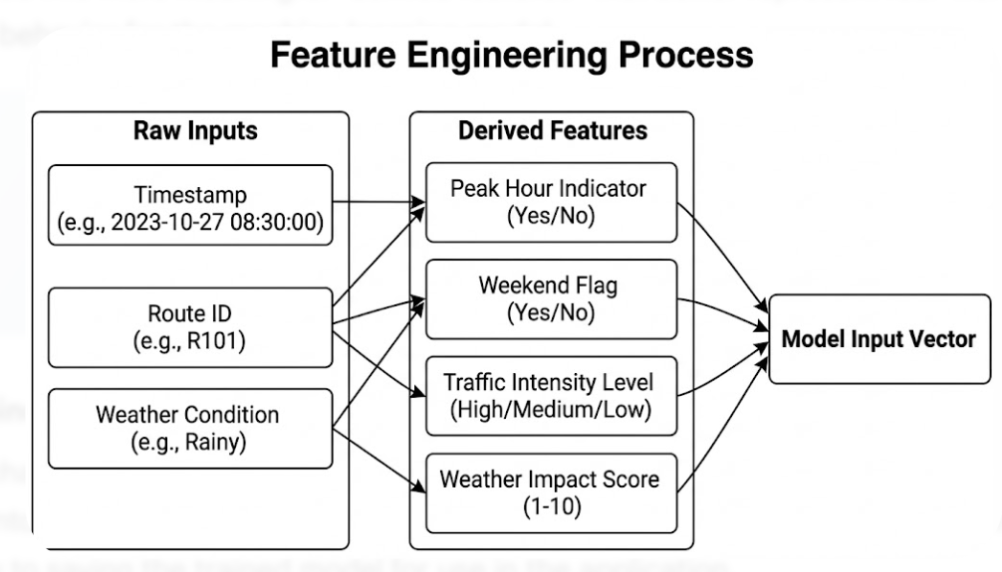
2. Data Handling Implementation
Transport schedule and route data are loaded using Python
Weather and time-based data are merged with transport data
Data is cleaned and converted into machine-readable format
Processed data is stored in SQLite database
3. Feature Engineering Implementation
Peak hour is identified using travel time
Weekend and weekday flags are created
Weather impact features are added
These features help the model understand real-world delay patterns

Slide 18
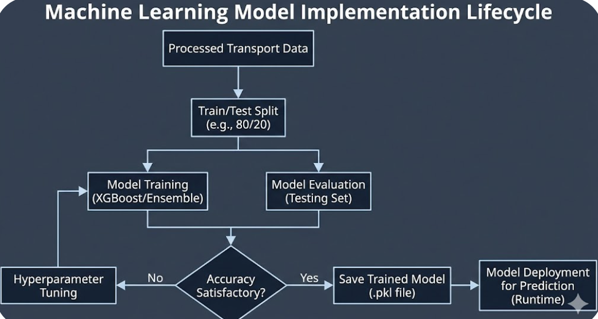
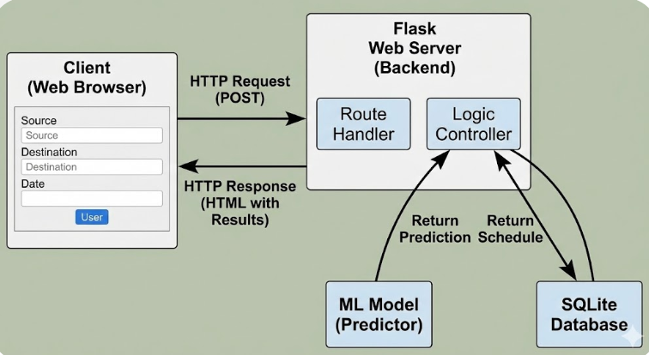
4. Machine Learning Model Implementation
XGBoost regression model is implemented
Dataset is split into training and testing sets
Model is trained using historical transport data
Trained model is saved for future predictions
5. Web Application Implementation
Flask framework is used to connect frontend and backend
User inputs source, destination, transport type, and date
Backend processes input and sends it to ML model
Predicted delay and arrival time are generated

Slide 19
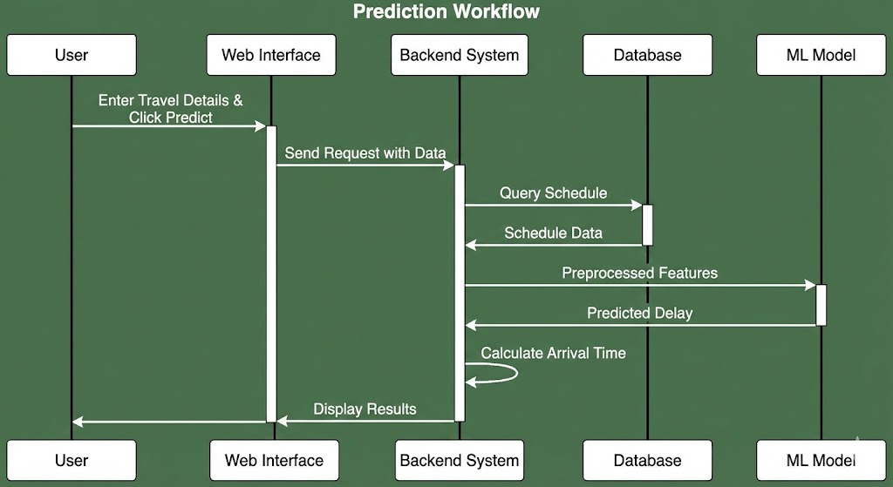
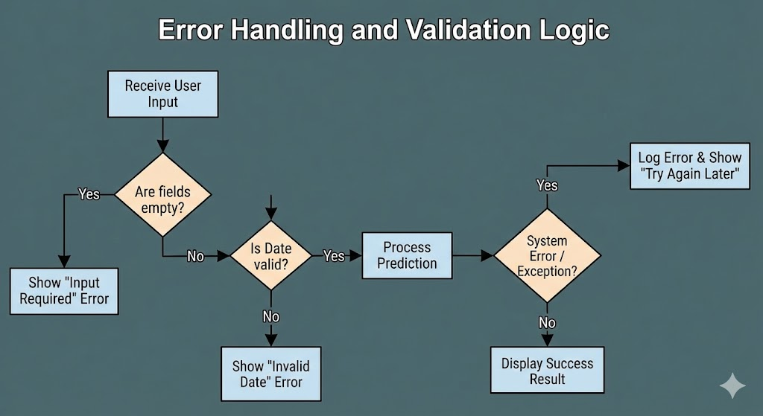
6. Prediction Workflow
User enters travel details
System fetches relevant data
Features are prepared in real time
ML model predicts delay duration
Expected arrival time is calculated
Result is displayed to the user
7. Error Handling and Validation
Invalid inputs are handled properly
Missing data is managed gracefully
System provides meaningful messages instead of errors

Slide 20
EXPERIMENTAL SETUP & RESULTS
Experimental Setup
Hardware: Intel i5, 8 GB RAM, 50 GB storage (64-bit)
Software: Windows / Linux, Python
Tools: VS Code, Jupyter Notebook
ML Libraries: NumPy, Pandas, Scikit-learn, XGBoost
Web & DB: Flask, SQLite
Dataset
Bus, Metro, and Train records
Route, transport type, scheduled & actual arrival time
Time features: hour, peak hour
Weather conditions: clear, rainy
Target: Delay (in minutes)
Results
Low prediction error
Accuracy: 85–90%
Works well during peak hours & bad weather
Prediction time: < 1 second

Slide 21
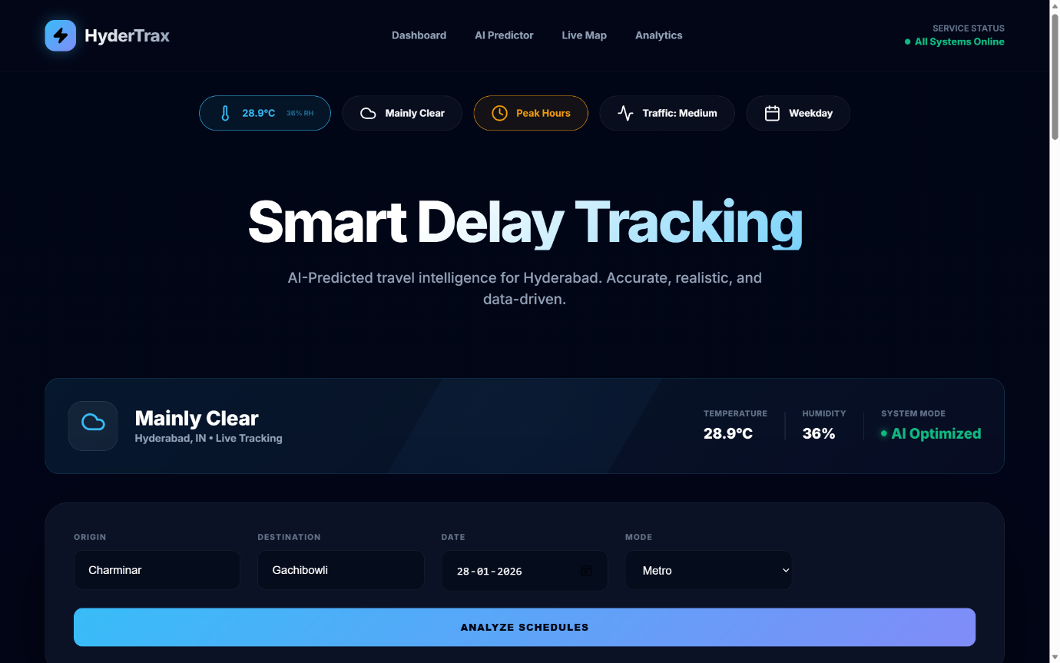
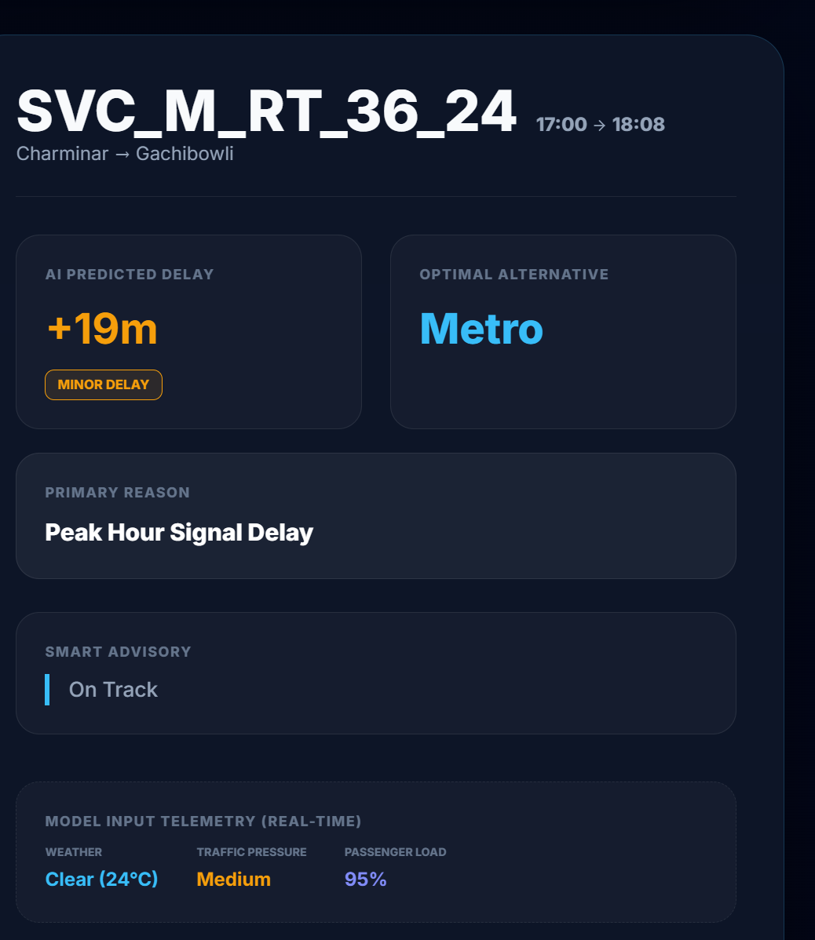
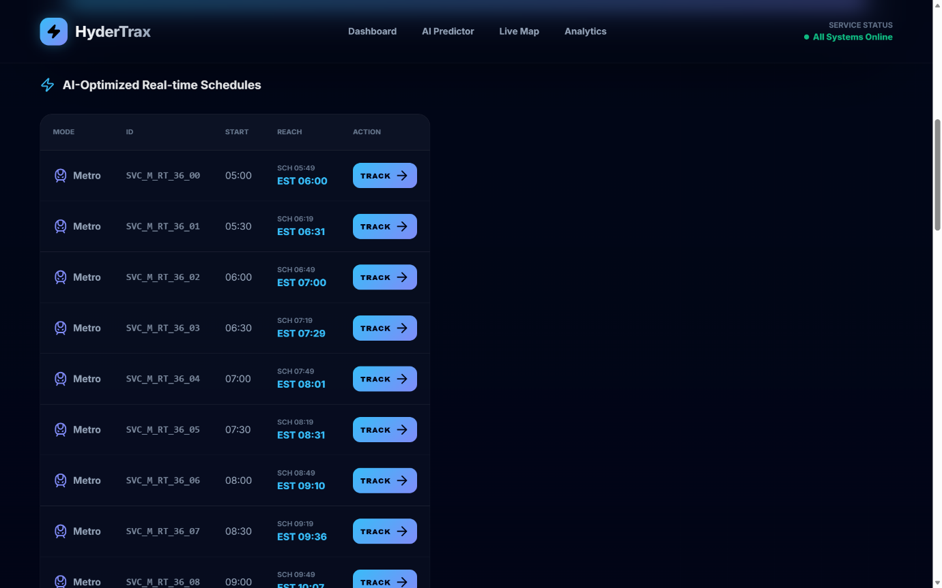
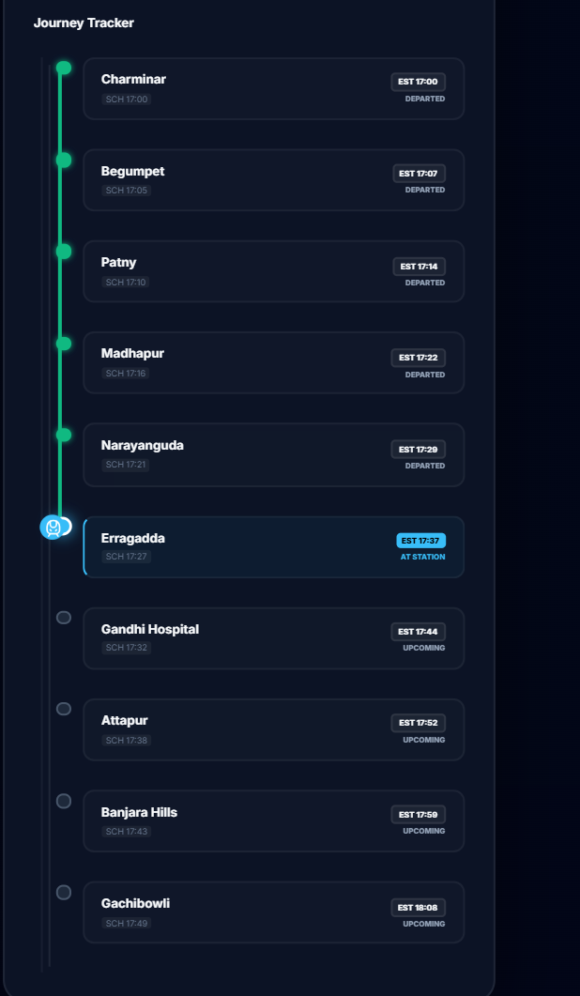
OUTPUT

Slide 22
APPLICATIONS
Helps daily commuters plan their travel efficiently
Provides accurate arrival time information
Reduces waiting time and uncertainty
Useful for bus, metro, and train services
Assists transport authorities in schedule planning
Supports smart city transportation systems
Improves overall public transport reliability

Slide 23
FUTURE SCOPE
Integration of real-time GPS tracking
Use of live traffic data for better accuracy
Mobile application for easy access
Support for more transport routes and cities
Advanced analytics for better delay prediction
Integration with smart city platforms

Slide 24
CONCLUSION
This project successfully demonstrates the use of machine learning to predict public transport delays and provide realistic arrival time information for commuters. By considering important factors such as traffic conditions, weather, and peak-hour travel, the system offers more accurate and reliable predictions compared to traditional timetable-based systems. The web-based application is easy to use and supports multiple transport modes including buses, metro, and trains. Overall, the proposed system improves journey planning, reduces travel uncertainty, and contributes to the development of smarter and more efficient public transportation systems.

Slide 25


